Slide 1
LINUX BASICS
PHANI KISHORE LANKA

Slide 2
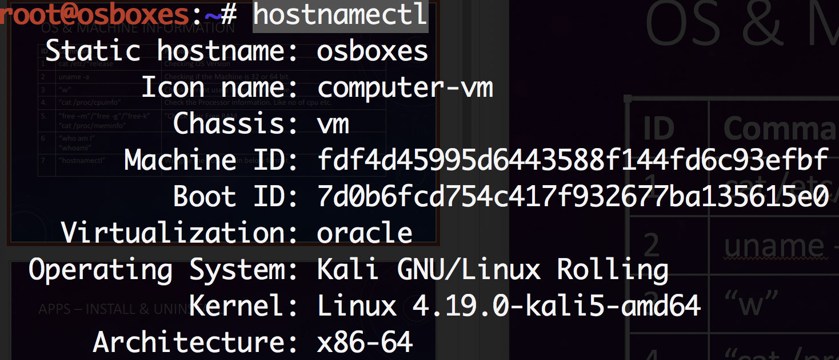
OS & Machine Information
ID | Command | Purpose
1 | cat /etc/*release ”cat /etc/issue” | Checking OS Version
2 | uname -a | Checking if the Machine is 32 or 64 bit.
3 | “w” | Check current users logged in machine.
4. | “cat /proc/cpuinfo” | Check the Processor information. Like no of cpu etc.
5. | ”free –m”/”free -g”/”free-k” “cat /proc/meminfo” | ”Check your Free RAM
6 | “who” “who am I” “whoami” | ”who” will show which user is logged in “who am i” will show the current user logged in “whoami” will print effective user id
7 | “hostnamectl” | Will give the host info in below format.
8 | “who” or “w” | Shall give you the list of users logged in the Machine

Slide 3
APPS – Install & UNINSTALL
ID | OS Type | Linux App Store | Updating Package Lists | Updating installed Packages
1 | Debian (ubuntu, kali, Debian) | apt, apt-cache, apt-get, dpkg | ”sudo apt update” | “sudo apt-get upgrade” (Only upgrades installed packages, where possible.) “sudo apt-get dist-upgrade” (May add or remove packages to satisfy new dependencies.) “sudo apt upgrade” (Like apt-get upgrade) “sudo apt full-upgrade” (Like apt-get dist-upgrade)
2 | Centos/RHEL/OEL | .rpm (installing using yum) | “yum check-update”
3 | Fedora | .rpm (dnf) | “dnf check-update”
Ubuntu/Debian | RHEL/OEL/Centos
apt upgrade or apt-get upgrade apt full-upgrade or apt-get dist-upgrade apt install <pkg-name> apt -y install <pkg-name> apt remove <pkg-name> apt-cache search <pkg-name> - give the pkg and description apt-cache showpkg <pkg-name> - list dependencies apt-cache show <pkg-name> - show pkg info. apt-get clean (clean the .deb files downloaded) apt-get download <pkg-name> - download witout install | yum install <pkg-name> yum -y install <pkg-name> yum -y groupinstall <group-name> yum search <pkg-name> yum -v repolist yum remove <pkg-name> yum reinstall <pkg-name> yum info <pkg-name> yum clean all --> Clean Yum Cache yum -y localinstall * --> install rpm files as yum.

Slide 4
FILE RELATED
ID | Command | Purpose
1 |  | List files
2 |  | Create files
3 |  | Copy files
 |  | Rename files /Move files
 |  | View file content
 |  | Head / tail files.

Slide 5
Directory RELATED
ID | Command | Purpose
1 |  | List files
2 |  | Create files
3 |  | Copy files
 |  | Rename files /Move files
 |  | View file content
 |  | Head / tail files.

Slide 6
SOFT & HARD LINKS
ID | Command | Purpose
1 |  | List files
2 |  | Create files
3 |  | Copy files
 |  | Rename files /Move files
 |  | View file content
 |  | Head / tail files.

Slide 7
USERS & GROUPS
ID | Command | Purpose
1 |  | List files
2 |  | Create files
3 |  | Copy files
 |  | Rename files /Move files
 |  | View file content
 |  | Head / tail files.

Slide 8
Mounts
ID | Command | Purpose

Slide 9
Important /etc files
ID | Command | Purpose

Slide 10
RUN LEVELS
ID | Command | Purpose

Slide 11
SYSTEM DATE & TIME RELATED
ID | Command | Purpose

Slide 12
Search
ID | Command | Purpose

Slide 13
System MONITORING
ID | Command | Purpose

Slide 14
USERS, GROUPS , PERMISSIONS
ID | Command | Purpose

Slide 15
PORTS & PROCESS
ID | Command | Purpose

Slide 16
ARCHIVING & UNARCHIVE

Slide 17
CRON JOBS

Slide 18
VI EDITOR

Slide 19
Sed

Slide 20
DISK RELATED

Slide 21
OPERATORS

Slide 22
WILD CARDS & META CHARACTERS

Slide 23
MISC

Slide 24
FILE TRANSFER

Slide 25
SSH-TRUST RSA KEYS

Slide 26
CONDITIONS

Slide 27
WHILE LOOP

Slide 28
FOR LOOP

Slide 29
CASE

Slide 31
IMPORTANT LINKS
Linux Command list -> https://ss64.com/
War Games Linux → https://overthewire.org/wargames/

